Slide 1
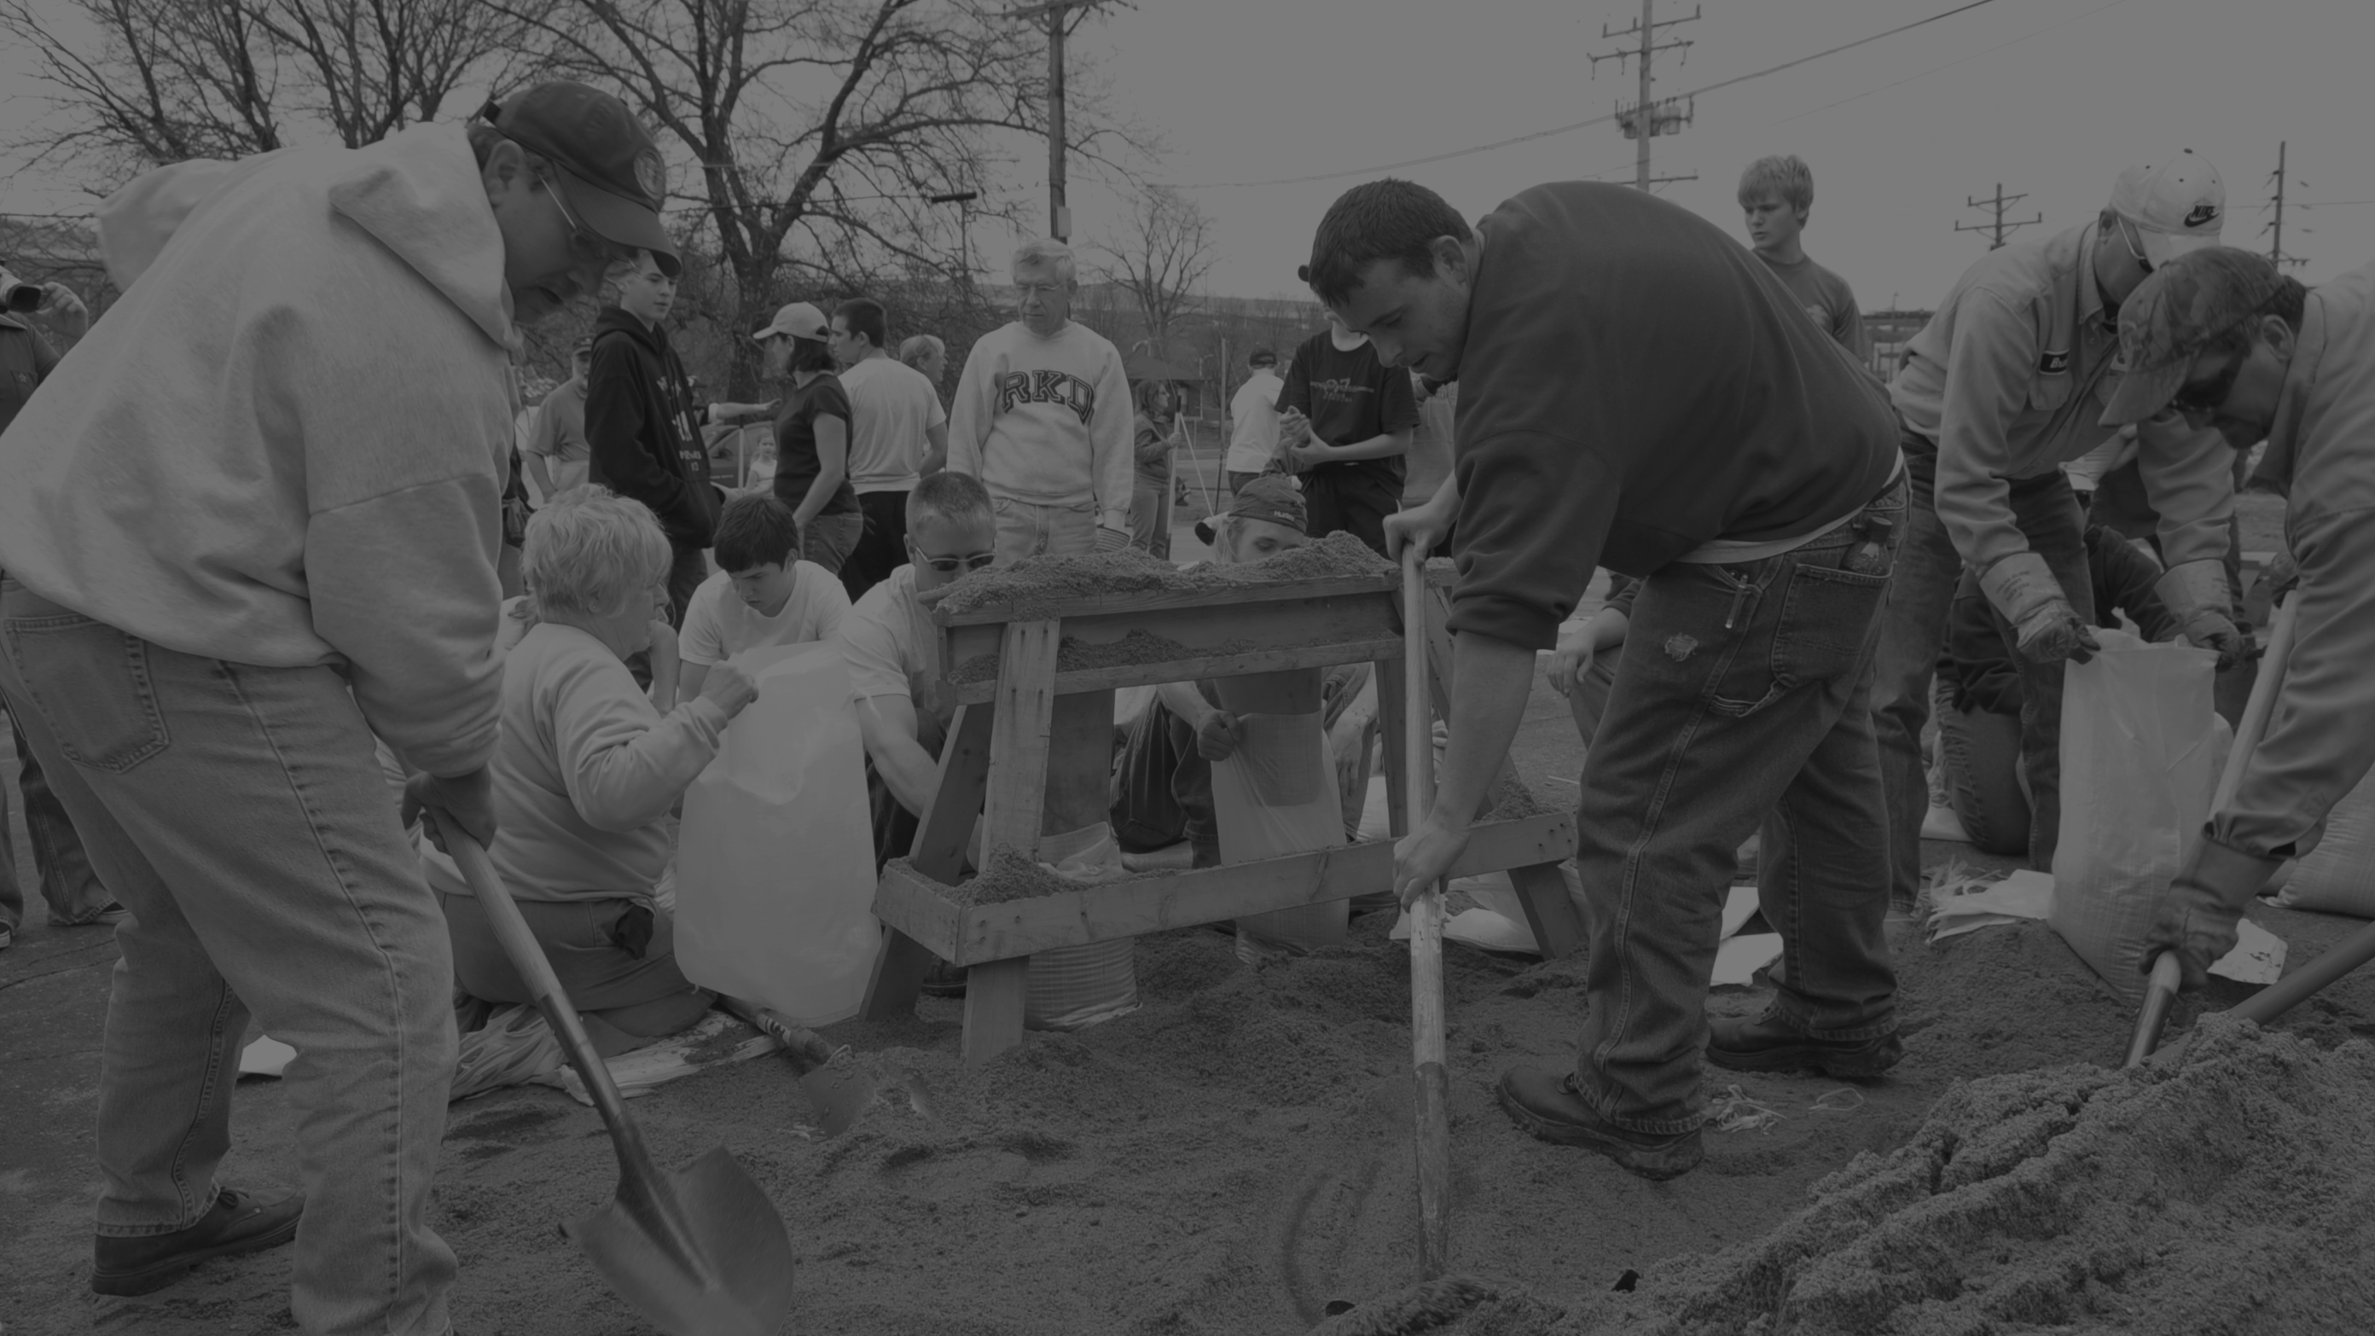
Ready to Respond
Tabletop Exercise

Slide 2
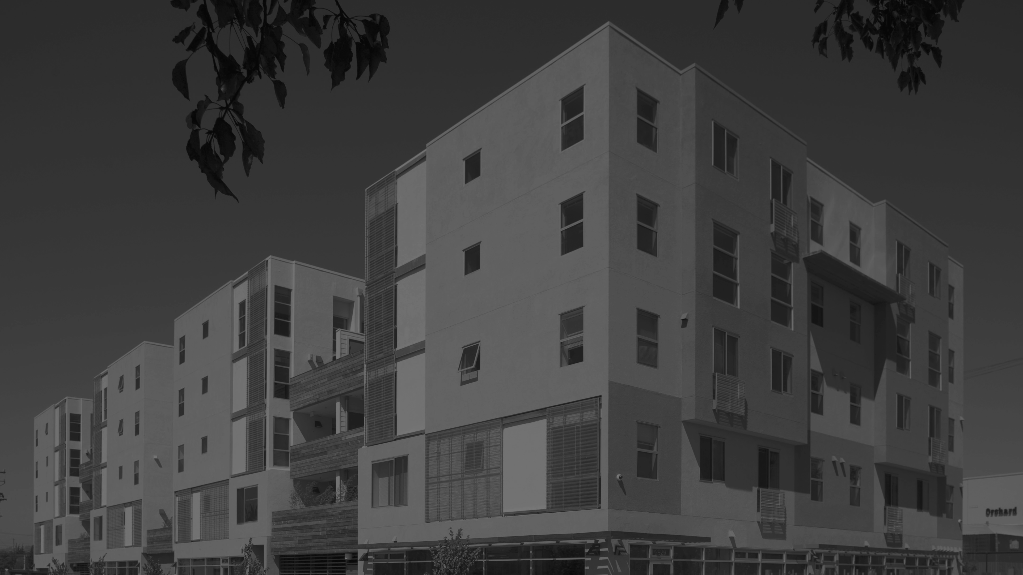
Welcome

Slide 3
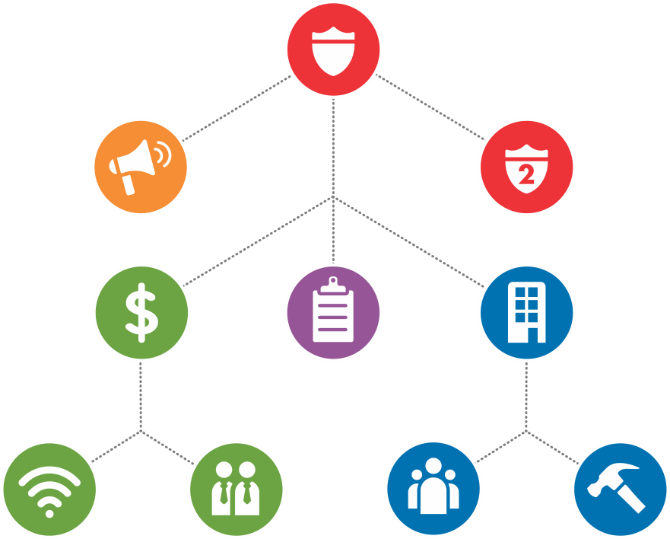
OUR RESPONSE TEAM
Insert Name
INCIDENT
COMMANDER
Insert Name
EXTERNAL
COMMUNICATIONS
LIAISON
Insert Name
COMMAND LEVEL
ADMINISTRATOR
(Optional)
Insert Name
BUSINESS
CONTINUITY CHIEF
Insert Name
HOUSING
CHIEF
Insert Name
LOGISTICS
CHIEF
Insert Name
IT
TEAM
LEADER
Insert Name
HUMAN
RESOURCES TEAM LEADER
Insert Name
RESIDENT
ENGAGEMENT
TEAM LEADER
Insert Name
BUILDING
PROTECTION
TEAM LEADER

Slide 4
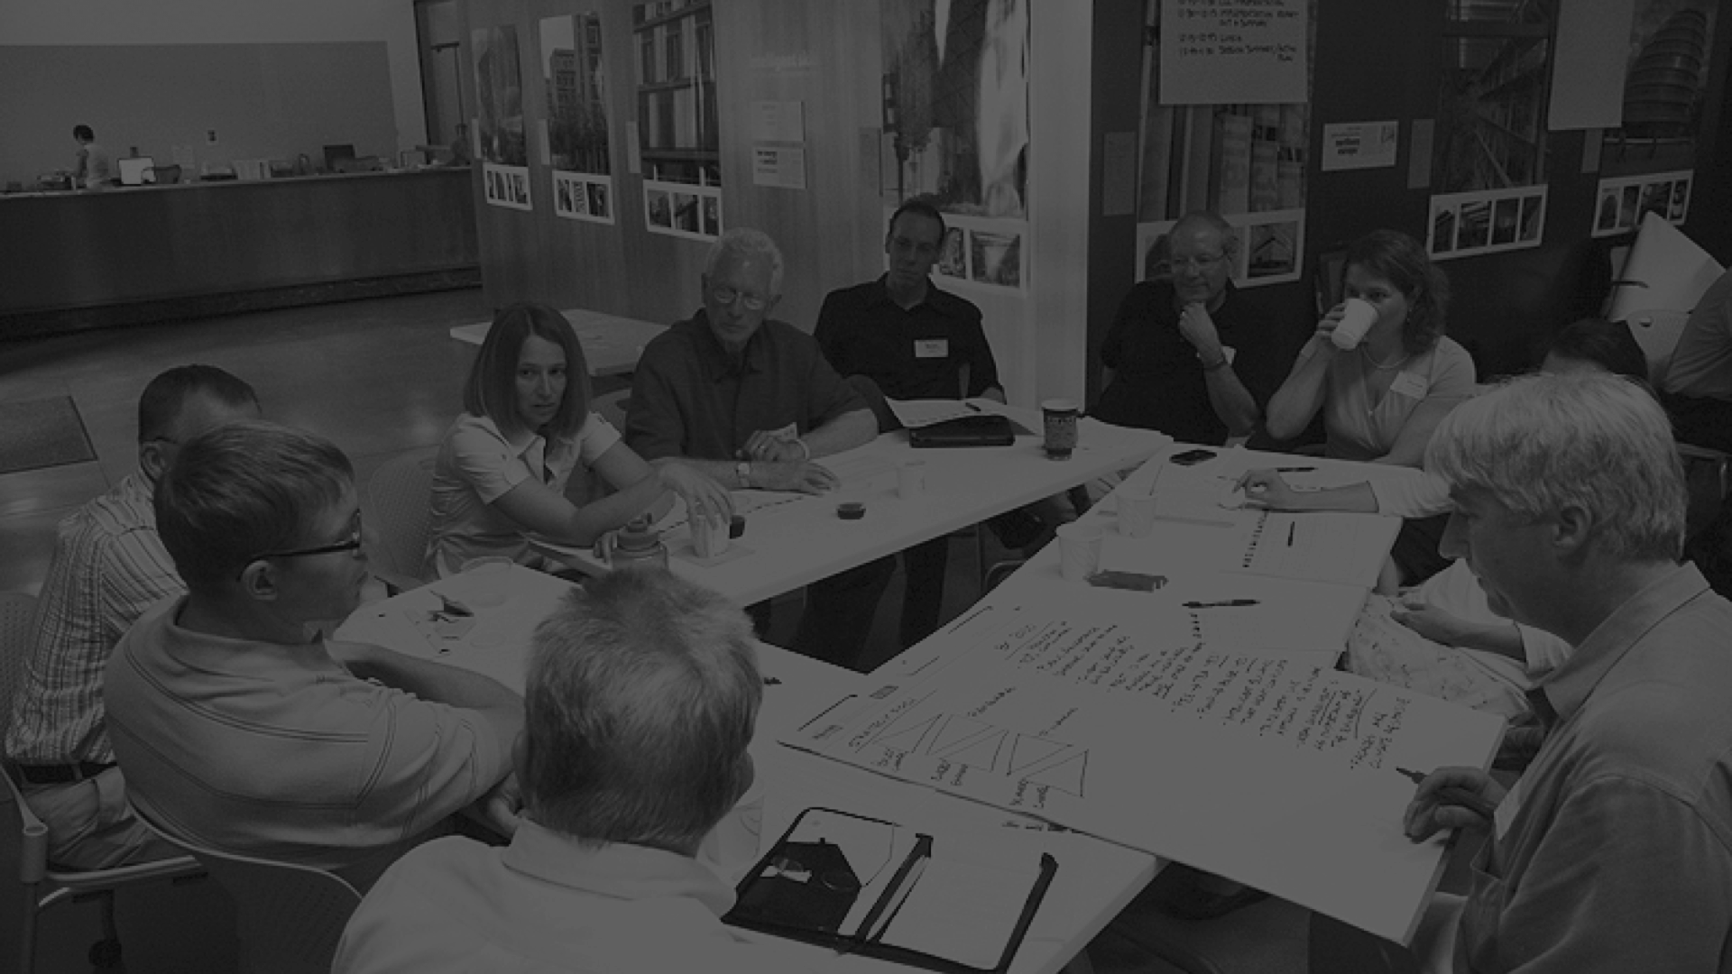
What is a Tabletop?

Slide 5

Training for real life disaster
Tests our ability to respond.
Includes a simulated disaster scenario.
Tests the strength of our Job Action Packets.
Let us practice communication between roles.

Slide 6

TODAY’S AGENDA
9:00 a.m.
9:30 a.m.
10:00 a.m.
10:15 a.m.
11:30 a.m.
11:45 a.m.
Introduction
Review of Tools
BREAK
Disaster scenario
Discussion
Next steps

Slide 7
Today’s objectives
Evaluate our Disaster Staffing Plan.
Ensure clarity of roles and responsibilities.
Evaluate our Job Action Packets.
Identify areas for improvement.

Slide 8
INCIDENT COMMAND SYSTEM CONCEPTS
The ICS model lays out staff roles and
tasks and the protocols needed for an
effective emergency response.
1
2
3
Common
Operating
Picture
Situational
Awareness
Operational
Periods

Slide 9
Common Operating Picture
1
Staff members understand the
organization’s protocols
and procedures.

Slide 10
Situational Awareness
2
Information about the disaster
and its effects is widely shared.

Slide 11
Operational Periods
3
Times when the Disaster Response Staffing Plan is implemented.
Pre-Event
Event
Post-Event
96 hours
72 hours
48 hours
24 hours
12 hours
Immediately
after
12 hours

Slide 12
CORE CAPABILITIES
Critical skills necessary to support an effective
disaster response.
Coordination
Communication
Information Sharing

Slide 13

CORE CAPABILITIES
Coordination
The organization works
in a unified manner across
departments and with
external stakeholders.

Slide 14

CORE CAPABILITIES
Communication
Staff and leadership
stay connected throughout
the disaster.

Slide 15

CORE CAPABILITIES
Information Sharing
Vital updates reach staff,
residents, leadership and
external stakeholders in a
timely manner.

Slide 16
What are we
preparing for?

Slide 17
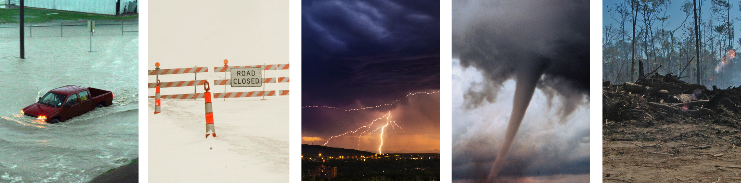

Predicted Disasters
Rain and
flooding
Snow
Storm
Tornado
Drought

Slide 18
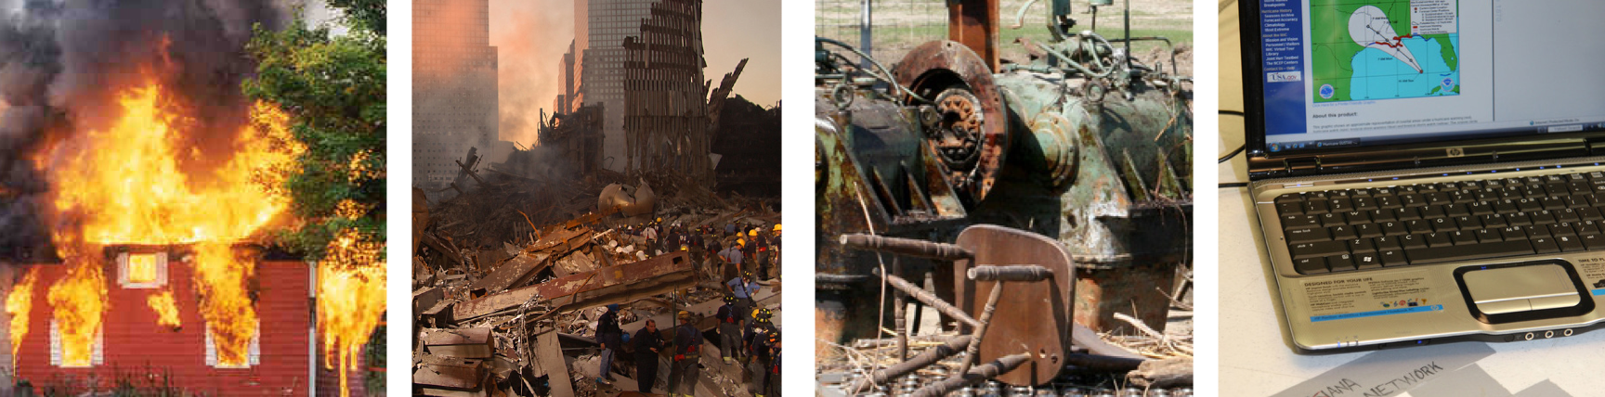
Sudden Disasters
Terrorist attack
Mechanical failure
IT security breach
Fire

Slide 19
What are the impacts?
Loss of power
Communications interruptions
Building damage
Evacuation
Staff and resident safety

Slide 20
Tools
Your Job Action Packet
Discussion Questions
Tabletop Evaluation Form

Slide 21
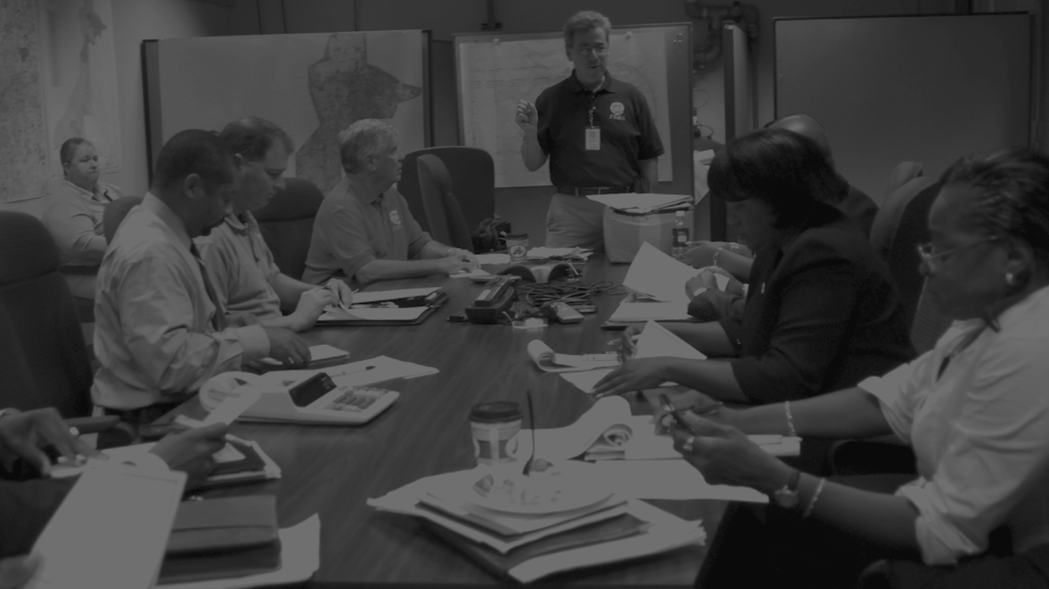
Disaster
Scenario: Hurricane

Slide 22

A series of
heat waves
around
your region

Slide 23
Excessive heat
as temperatures
hit 105 degrees

Slide 24
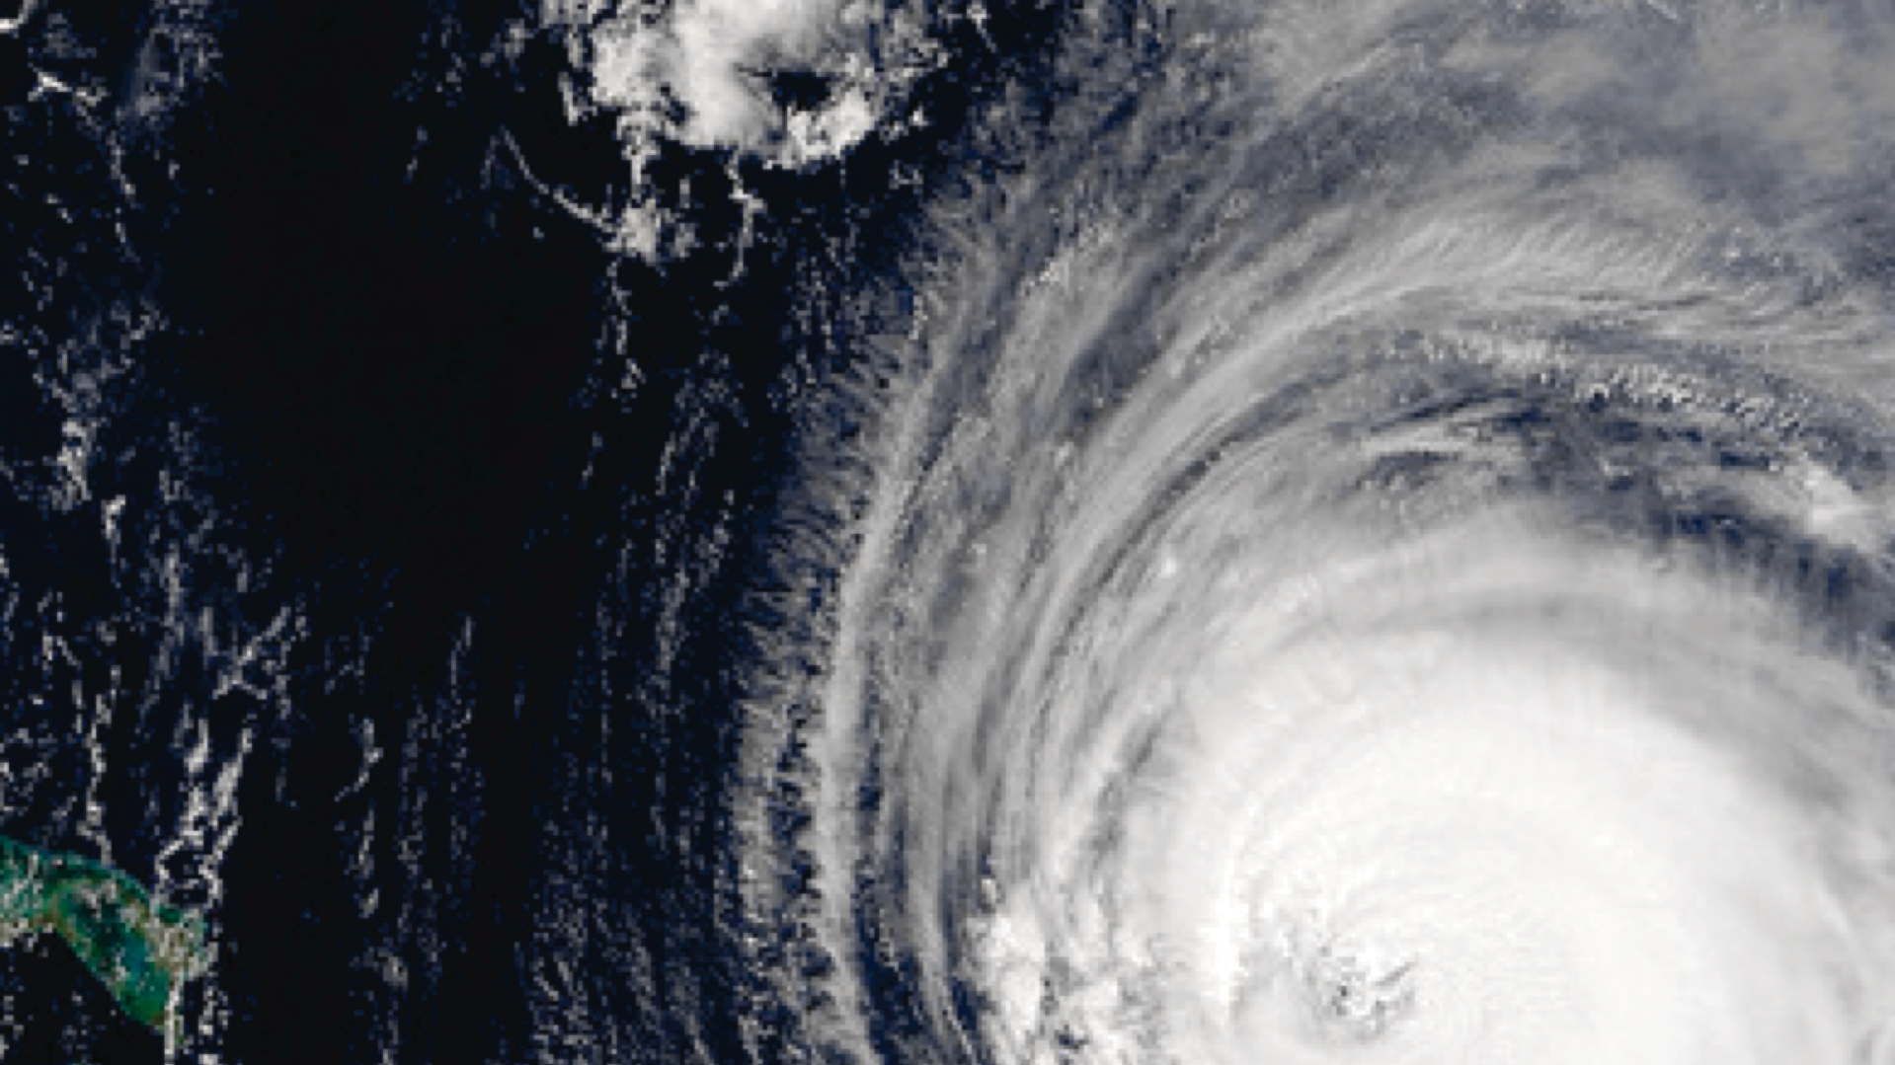
Category 3
hurricane
expected to pass
through area
within 96 hours

Slide 25
Pre-Event
96 hours

Slide 26
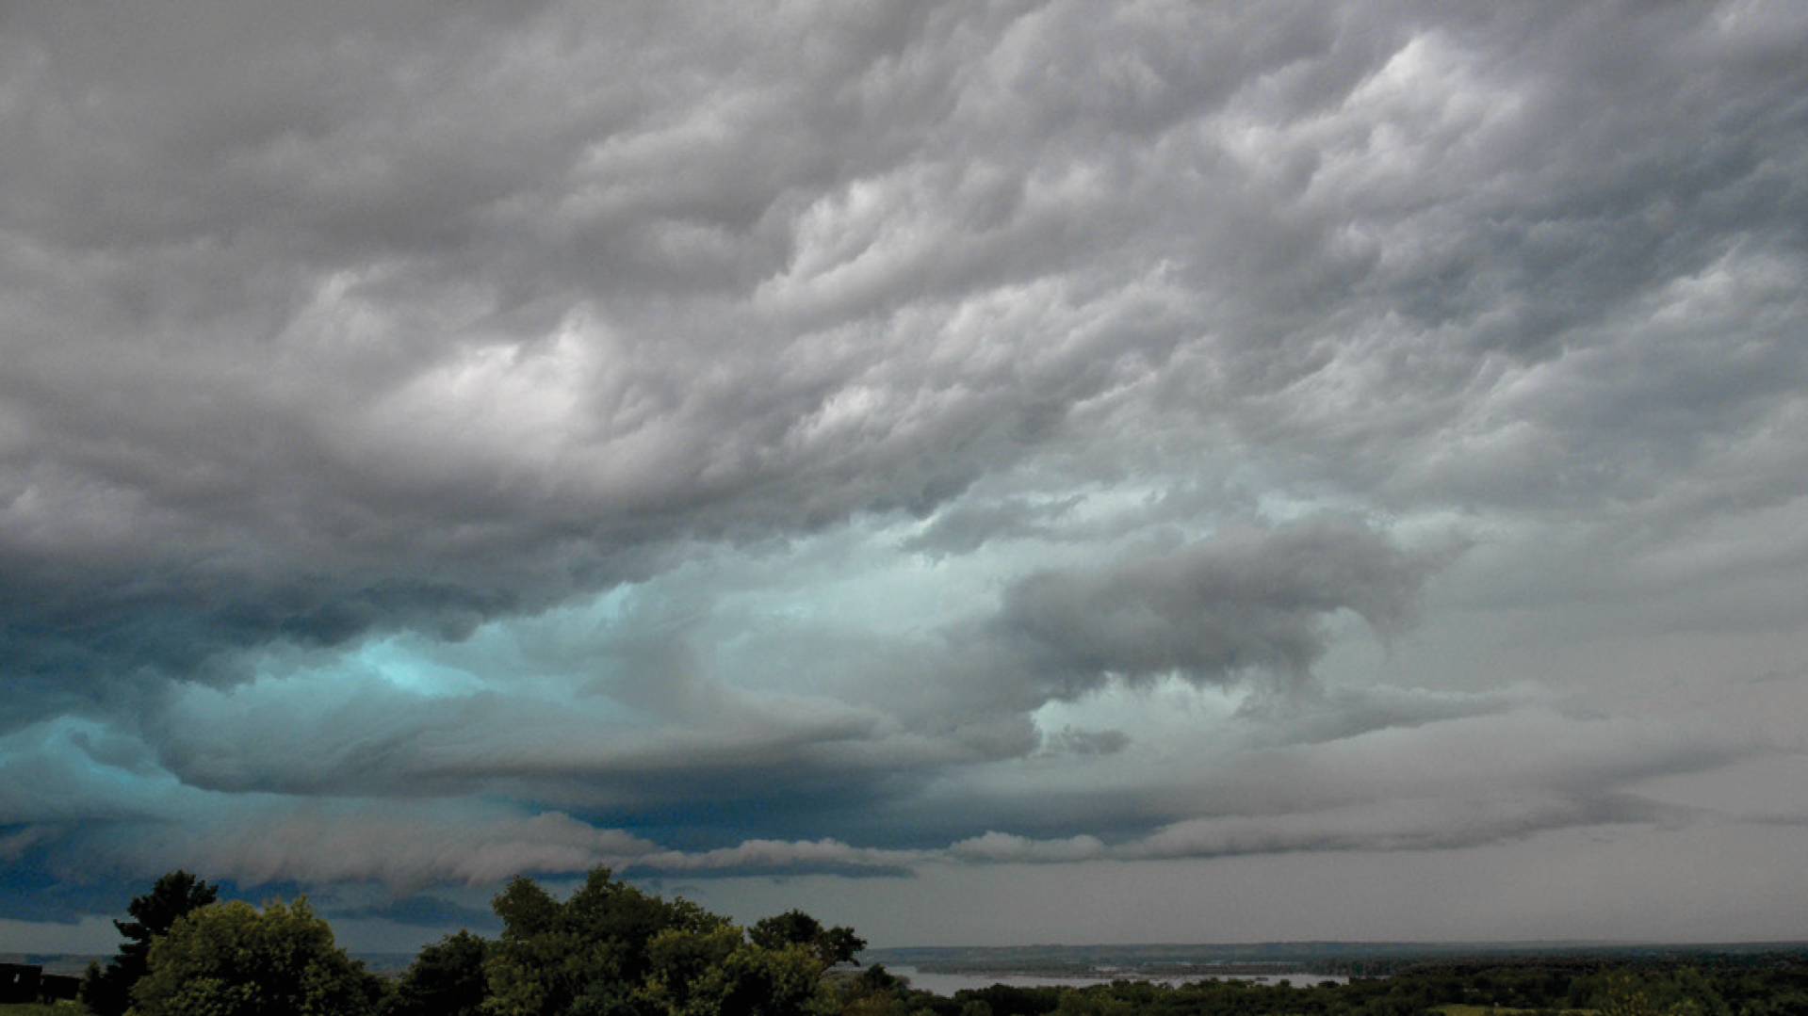
Monday, August 1
Pre-Event
96 hours

Slide 27
Monday, August 1
Pre-Event
96 hours
Hurricane expected to hit
late Thursday night or early Friday morning.

Slide 28
Monday, August 1
Pre-Event
96 hours
Air temperature has
reached 105 degrees and brownouts suspected throughout the region.

Slide 29
Monday, August 1
Pre-Event
96 hours
Residents are getting nervous
and starting to ask questions about preparedness.

Slide 30

Monday, August 1
Pre-Event
96 hours
What key decisions need
to be made?

Slide 31
Monday, August 1
Pre-Event
96 hours
What are your tasks during this operational period?

Slide 32
Monday, August 1
Pre-Event
96 hours
How are you working and communicating with others?

Slide 33
Monday, August 1
Pre-Event
96 hours
What key decisions need to be made?
What are your tasks during this operational period?
How are you working and communicating
with others?

Slide 34
Pre-Event
72 hours

Slide 35
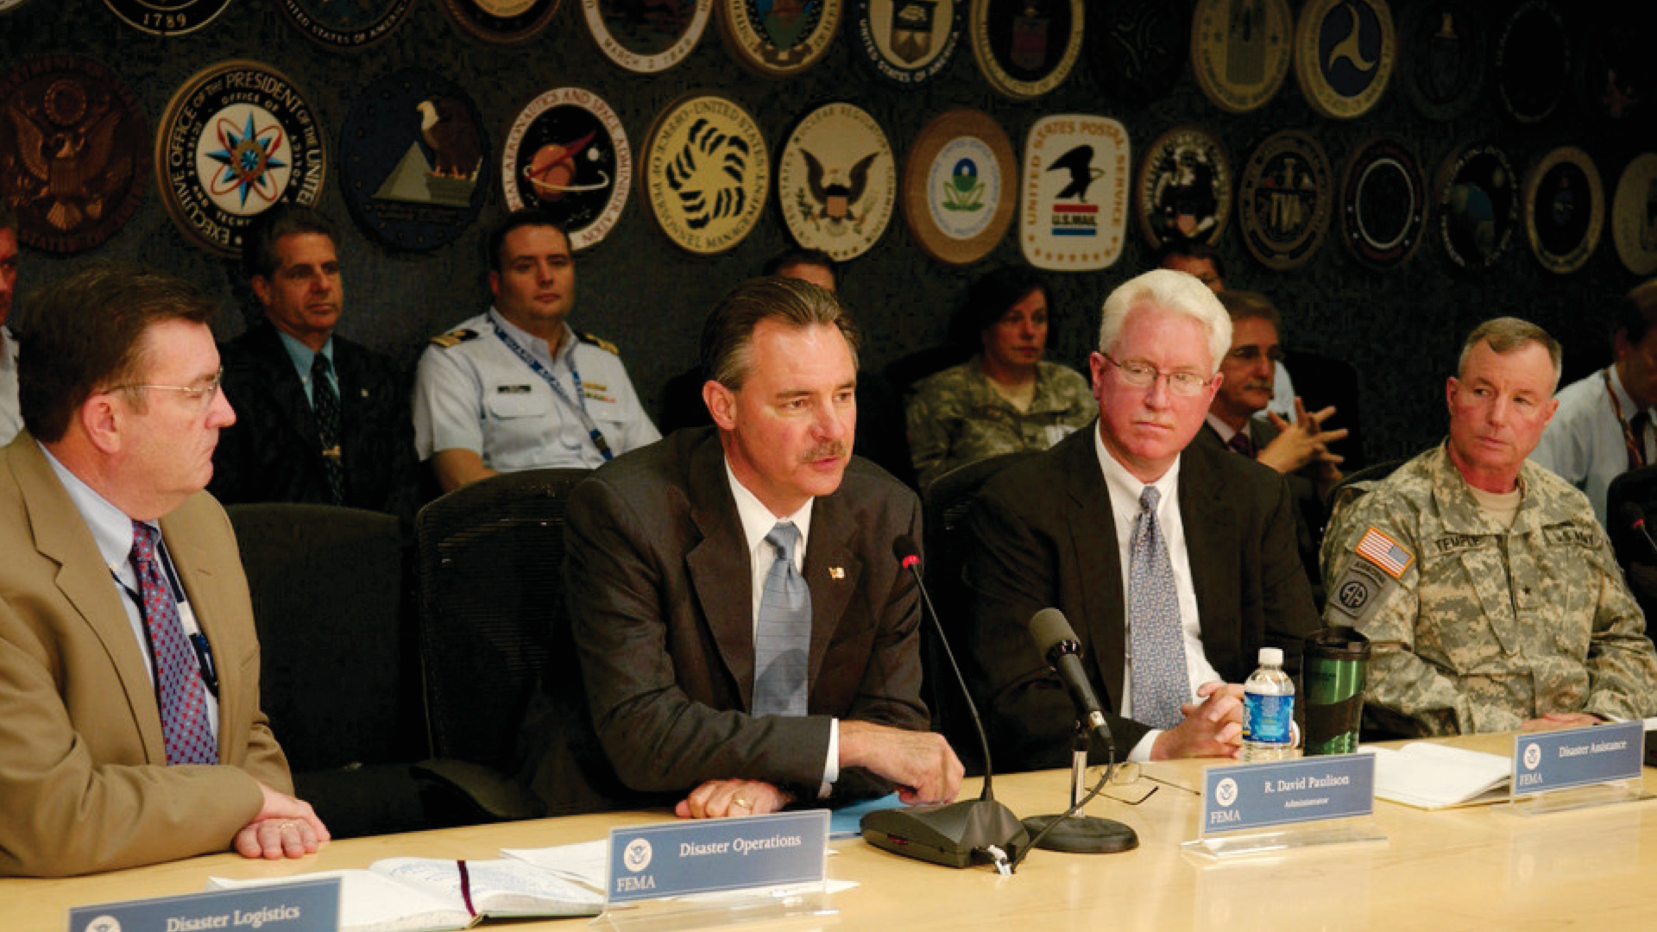
Tuesday, August 2
Pre-Event
72 hours

Slide 36
Tuesday, August 2
Pre-Event
72 hours
Municipal Emergency Operations Center activated.

Slide 37
Tuesday, August 2
Pre-Event
72 hours
News coverage
intensifies.

Slide 38
Tuesday, August 2
Pre-Event
72 hours
Expected storm surge of
15+ feet and 110mph winds.

Slide 39
Tuesday, August 2
Pre-Event
72 hours
What key decisions need
to be made?

Slide 40
Tuesday, August 2
Pre-Event
72 hours
What are your tasks during this operational period?

Slide 41
Tuesday, August 2
Pre-Event
72 hours
How are you working and communicating with others?

Slide 42
Tuesday, August 2
Pre-Event
72 hours
What key decisions need to be made?
What are your tasks during this operational period?
How are you working and communicating
with others?

Slide 43
Pre-Event
48 hours

Slide 44
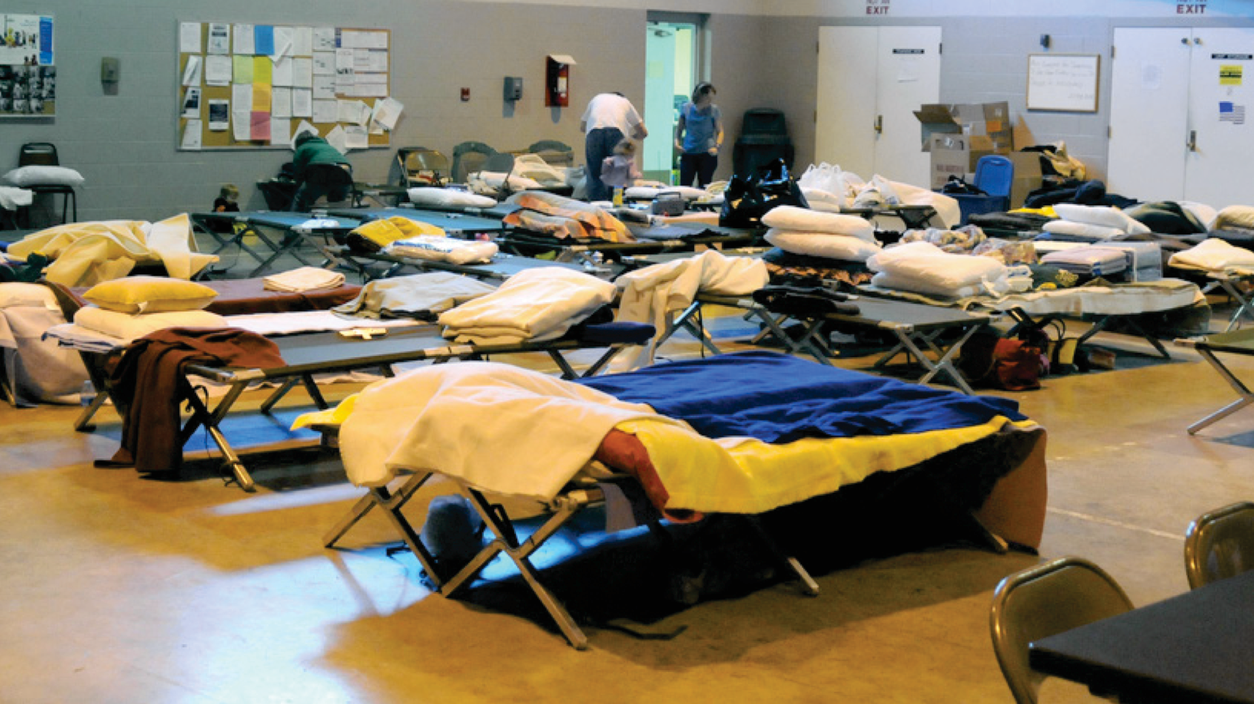
Wednesday, August 3
Pre-Event
48 hours

Slide 45
Wednesday, August 3
Pre-Event
48 hours
Area shelters
are opened.

Slide 46
Wednesday, August 3
Pre-Event
48 hours
First responder agencies
put on emergency footing.

Slide 47
Wednesday, August 3
Pre-Event
48 hours
News coverage
intensifies.

Slide 48
Wednesday, August 3
Pre-Event
48 hours
What key decisions need
to be made?

Slide 49
Wednesday, August 3
Pre-Event
48 hours
What are your tasks during this operational period?

Slide 50
Wednesday, August 3
Pre-Event
48 hours
How are you working and communicating with others?

Slide 51
Wednesday, August 3
Pre-Event
48 hours
What key decisions need to be made?
What are your tasks during this operational period?
How are you working and communicating
with others?

Slide 52
Pre-Event
24 hours

Slide 53
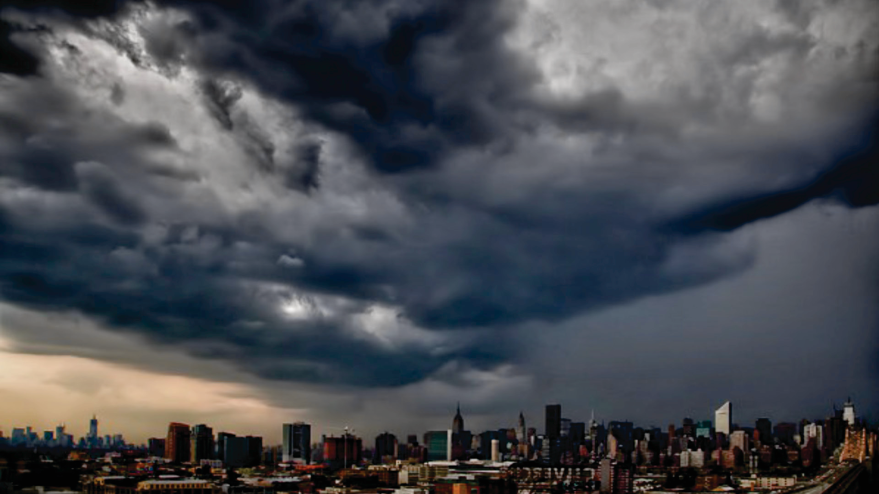
Thursday, August 4
Pre-Event
24 hours

Slide 54
Thursday, August 4
Pre-Event
24 hours
Bridges and transit shut down
at 3:00 a.m. No more deliveries over bridges.

Slide 55
Thursday, August 4
Pre-Event
24 hours
Gale force winds by 5:00 a.m.

Slide 56
Thursday, August 4
Pre-Event
24 hours
Rain and surge expected Friday morning.

Slide 57
Thursday, August 4
Pre-Event
24 hours
Rainfall expected to be
12-18 inches.

Slide 58
Thursday, August 4
Pre-Event
24 hours
What key decisions need
to be made?

Slide 59
Thursday, August 4
Pre-Event
24 hours
What are your tasks during this operational period?

Slide 60
Thursday, August 4
Pre-Event
24 hours
How are you working and communicating with others?

Slide 61
Thursday, August 4
Pre-Event
24 hours
What key decisions need to be made?
What are your tasks during this operational period?
How are you working and communicating
with others?

Slide 62
Pre-Event
12 hours

Slide 63
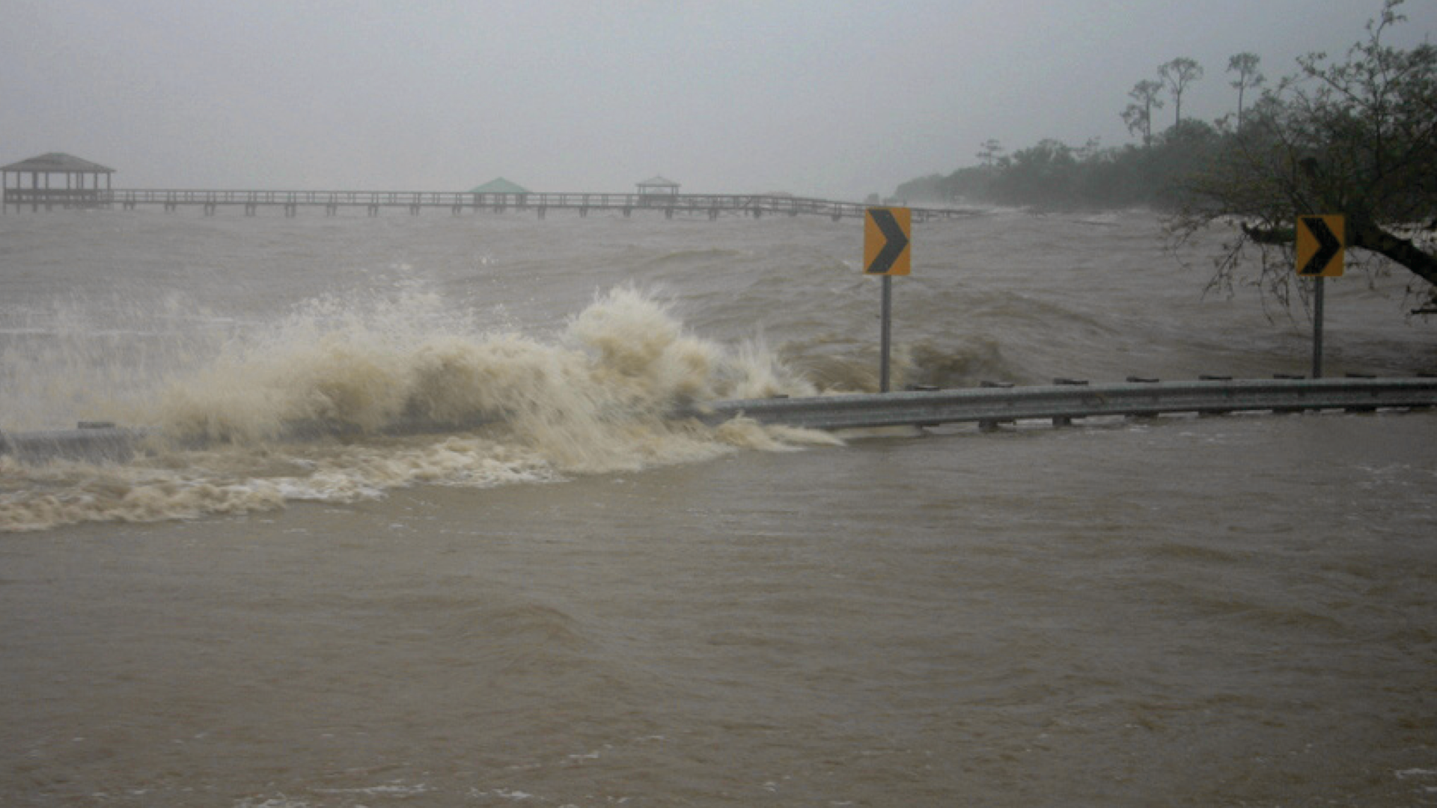
Friday, August 5
Pre-Event
12 hours

Slide 64
Friday, August 5
Pre-Event
12 hours
Public shelters are filling up with evacuees.

Slide 65
Friday, August 5
Pre-Event
12 hours
Government officials are urging residents to stay off roads and streets.

Slide 66
Friday, August 5
Pre-Event
12 hours
Winds increasing in speed.

Slide 67
Friday, August 5
Pre-Event
12 hours
Rainfall predictions
remain at 12-18 inches.

Slide 68
Friday, August 5
Pre-Event
12 hours
What key decisions need
to be made?

Slide 69
Friday, August 5
Pre-Event
12 hours
What are your tasks during this operational period?

Slide 70
Friday, August 5
Pre-Event
12 hours
How are you working and communicating with others?

Slide 71
Friday, August 5
Pre-Event
12 hours
What key decisions need to be made?
What are your tasks during this operational period?
How are you working and communicating
with others?

Slide 72
Event

Slide 73
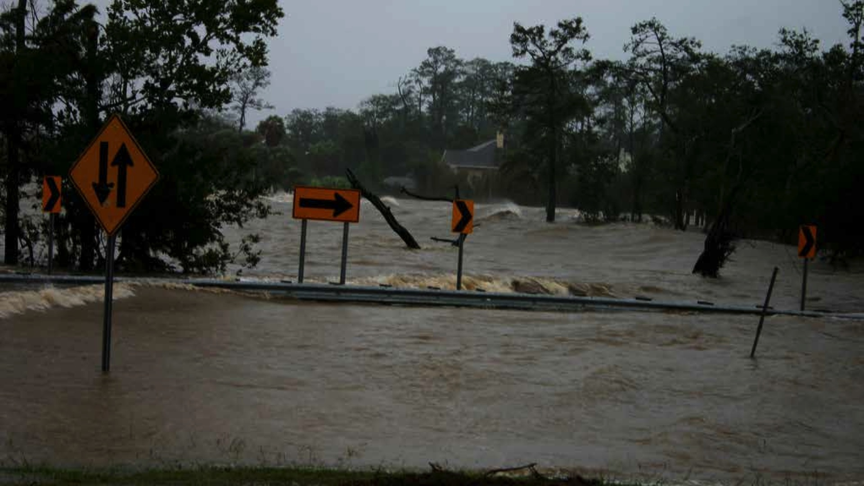
Friday, August 5
Event

Slide 74
Friday, August 5
Event
12 foot surge hits
your area at 3:00 a.m.

Slide 75
Friday, August 5
Event
Power out throughout
your region.

Slide 76
Friday, August 5
Event
Bridges and tunnels blocked by windblown debris.

Slide 77
Friday, August 5
Event
Streets are flooded and
there is no access on main roads.

Slide 78
Friday, August 5
Event
What key decisions need
to be made?

Slide 79
Friday, August 5
Event
What are your tasks during this operational period?

Slide 80
Friday, August 5
Event
How are you working and communicating with others?

Slide 81
Friday, August 5
Event
What key decisions need to be made?
What are your tasks during this operational period?
How are you working and communicating
with others?

Slide 82
Post Event
Immediately after

Slide 83
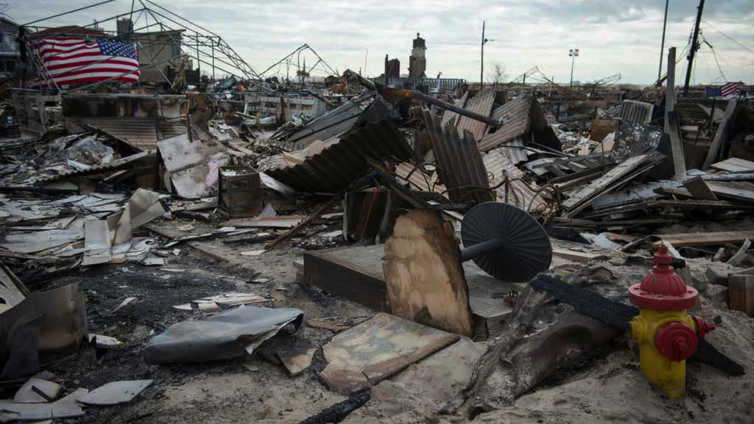
Saturday, August 6
Post-Event
Immediately
after

Slide 84
Saturday, August 6
Post-Event
Immediately
after
Surge receded by 6:00 a.m.

Slide 85
Saturday, August 6
Post-Event
Immediately
after
Winds gusting at 45mph

Slide 86
Saturday, August 6
Post-Event
Immediately
after
Engineers report your buildings sustained minor damage.

Slide 87
Saturday, August 6
Post-Event
Immediately
after
Communications sporadic throughout city.

Slide 88
Saturday, August 6
Post-Event
Immediately
after
What key decisions need
to be made?

Slide 89
Saturday, August 6
Post-Event
Immediately
after
What are your tasks during this operational period?

Slide 90
Saturday, August 6
Post-Event
Immediately
after
How are you working and communicating with others?

Slide 91
Saturday, August 6
Post-Event
Immediately
after
What key decisions need to be made?
What are your tasks during this operational period?
How are you working and communicating
with others?

Slide 92
Post Event
12 hours

Slide 93
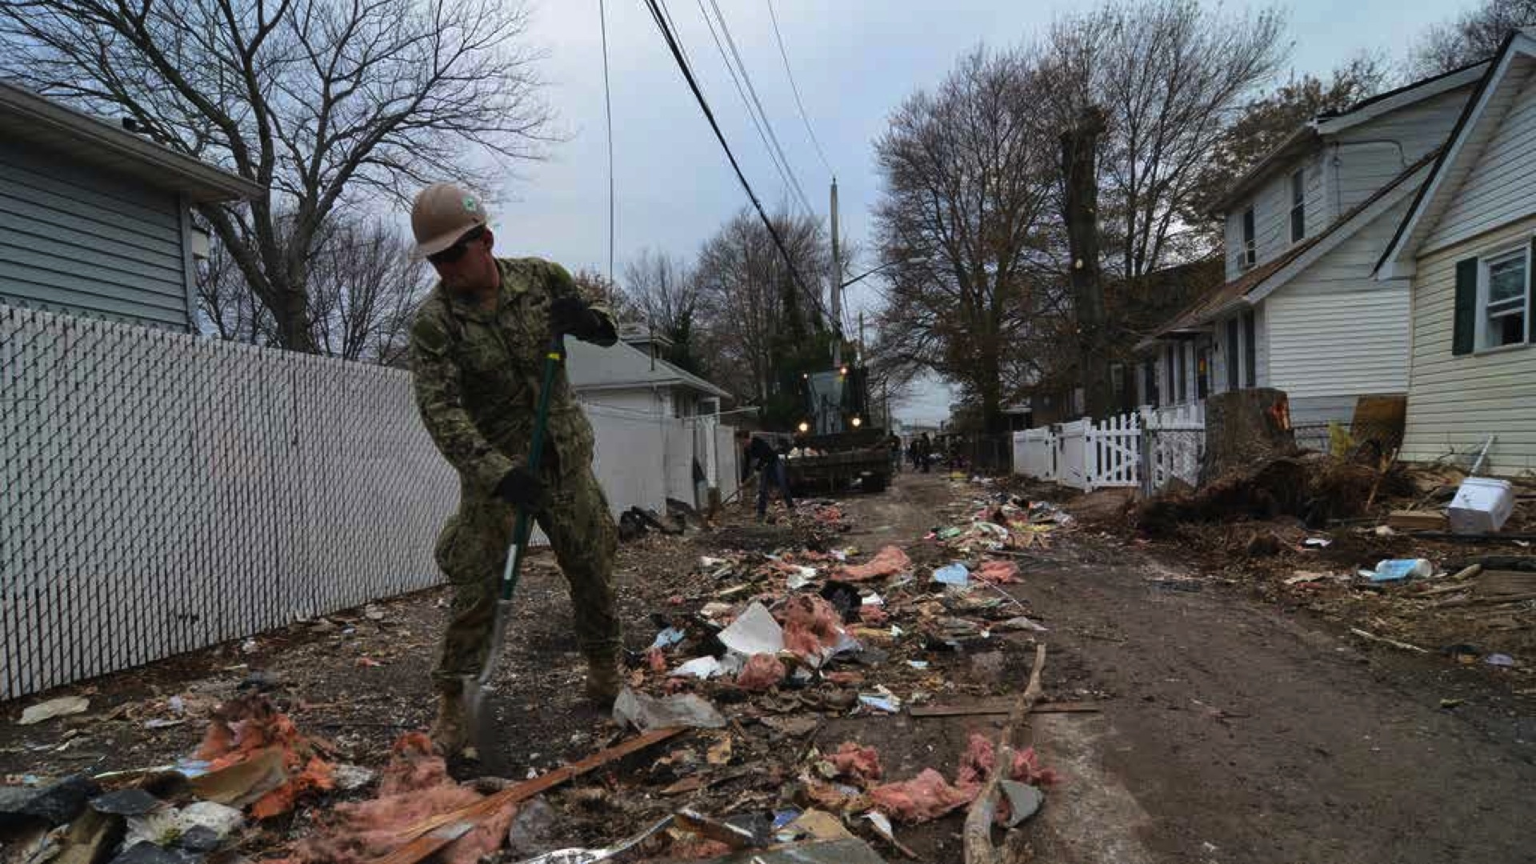
Saturday, August 6
Post-Event
12 hours

Slide 94
Saturday, August 6
Post-Event
12 hours
Weather conditions return to normal.

Slide 95
Saturday, August 6
Post-Event
12 hours
Communications restored.

Slide 96
Saturday, August 6
Post-Event
12 hours
Building elevators remain
non-operational.

Slide 97
Saturday, August 6
Post-Event
12 hours
Roads reopen and cleanup efforts are underway.

Slide 98
Saturday, August 6
Post-Event
12 hours
What key decisions need
to be made?

Slide 99
Saturday, August 6
Post-Event
12 hours
What are your tasks during this operational period?

Slide 100
Saturday, August 6
Post-Event
12 hours
How are you working and communicating with others?

Slide 101
Saturday, August 6
Post-Event
12 hours
What key decisions need to be made?
What are your tasks during this operational period?
How are you working and communicating
with others?

Slide 102
Discussion
What went well?
What didn’t go well?
What areas can be improved?

Slide 103
Next steps
Complete the Tabletop Evaluation Form
Revise Job Action Sheets and Tools

